Slide 1
Enterprise Architecture EA – CS544
Presented By:
Purushottam Prajapati

Slide 2
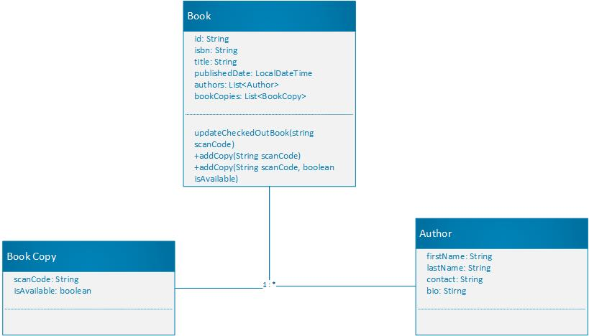
Class Diagram – Book Catalog

Slide 3
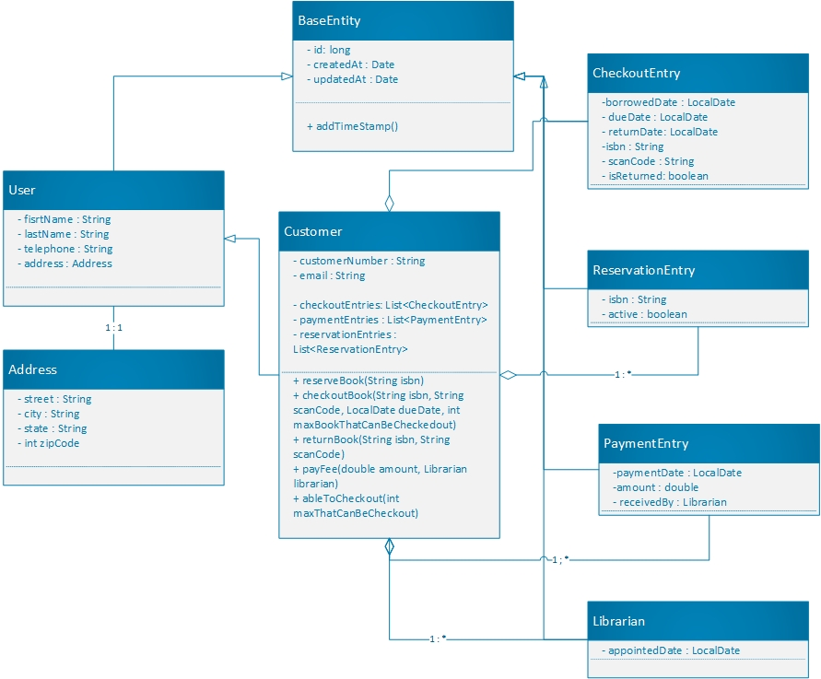
Class Diagram - Library

Slide 4
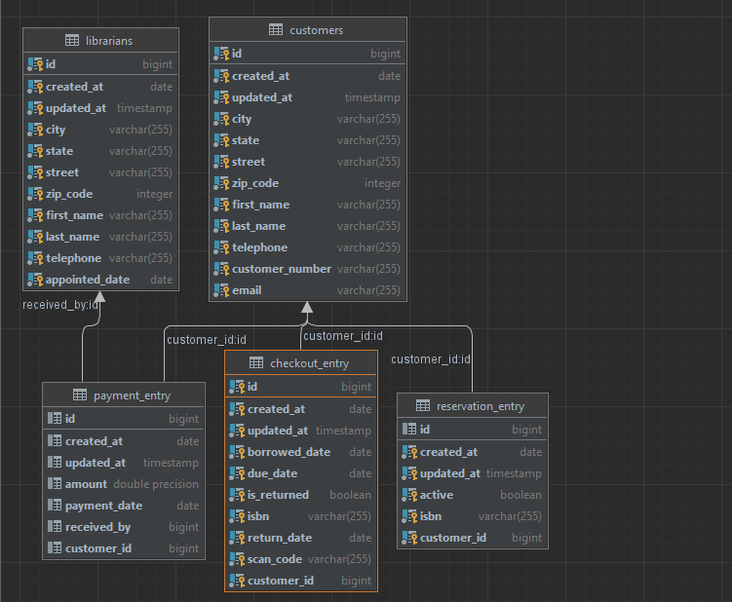
ER-Diagram - Library

Slide 5
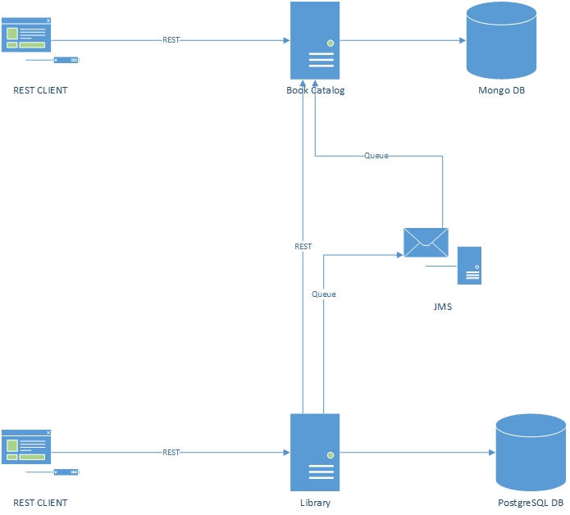
Architectural Diagram

Slide 6
Patterns and Techniques used
DDD Approach
Entities
Domain Services
Message Queue
REST
Testing
Unit Test
Controller Test
Rest assured Test

Slide 7





Technology Used

Slide 8
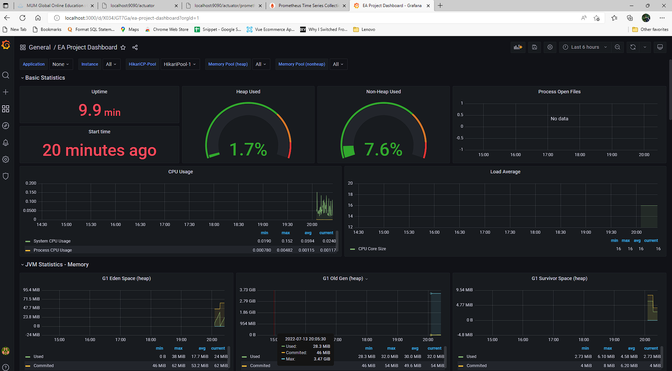
Grafana Dashboard

Slide 9
Demo

Slide 10
Thank You

